Slide 1
Interconnection networks
Characteristic of multiprocessor system – ability of each processor to share a set of main memory modules and I/O devices. This sharing capability is provided through a set of 2 interconnection n/ws.
One b/w the processor and memory modules
other b/w processors and I/o subsystem.

Slide 2
Time shared or common bus
The simplest interconnection system for multiple processors is a common communication path connecting all of the functional units.
eg of a multiprocessor system using a common communication path

Slide 3
Common path is called a time shared or common bus.
---is the least complex and easiest to reconfigure.
Such an interconnection n/w is a passive unit having no active components such as switches.
Transfer operations are controlled completely by the bus interfaces of the sending and receiving units. Since the bus is a shared resource, a mechanism must be provided to resolve contention.
An eg of the time shared bus is the PDP -11.

Slide 4
The single bus organization is quite reliable and relatively inexpensive, it does introduce a single critical component in the system that can cause complete system failure as a result of a malfunction in any of the bus interface circuits.
System expansion by adding more processors or memory increases the bus contention, which degrades system throughput and increases arbitration logic.
The total overall transfer rate within the system is limited by the bandwidth and speed of this single path.

Slide 5
An extension of the single path organization to 2 unidirectional paths.

Slide 6
Multiple bidirectional buses can be used to permit multiple simultaneous bus transfers.

Slide 7
Time shared or common buses
I/O
processor
Memory
module
Memory
module
I/O
processor
Processor
Processor
Multiprocessor with unidirectional buses
Bus
modifier
Control
logic
Processor
Processor
Memory
units
I/O
devices
Multi-bus multiprocessor organizations
I/O0
M0
M1
M2
I/O1
P0
P1
P2

Slide 8
Algorithms for bus arbitration
Static priority algorithm
Digital buses assign unique static priorities to the requesting devices.
When multiple devices concurrently request use of the bus, device with the highest priority is granted access to it.
This approach is implemented using a scheme called daisy chaining, in which all services are effectively assigned static priorities according to their locations along a bus grant control line.

Slide 9
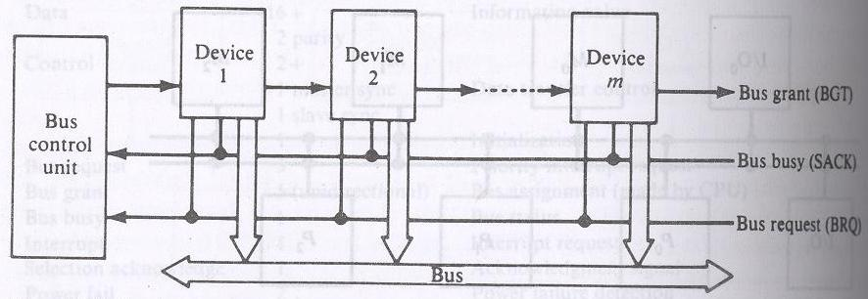
Static daisy chain implementation of a system bus

Slide 10
Device close to the central bus controller is assigned the highest priority.
Requests are made on a common request line, BRQ. The central bus control unit propagates a bus grant signal BGT if the acknowledge signal SACK indicates that the bus is idle.

Slide 11
Fixed time slice algorithm
This divides the available bus band width into fixed length time slices that are then sequentially offered to each device in a round robin fashion. Should the selected device elect not to use the time slice, the time slice remains unused by any device.
The technique is called fixed time slicing (FTS) or time division multiplexing (TMD).

Slide 12
Dynamic priority algorithm
----LRU(least recently used)
----RDC(rotating daisy chain)
The LRU algorithm gives the highest priority to the requesting device that has not used the bus for the longest interval. This is accomplished by reassigning priorities after each bus cycle.
In the daisy chain scheme all devices are given static and unique priorities on a bus grant line emanating from a central controller.

Slide 13
In the RDC scheme, no central controller exists and the bus grant line is connected from the last device back to the first in a closed loop. Whichever device is granted access to the bus serves as the bus controller for the following arbitration.

Slide 14
Device
1
Device
2
Device
m
Partial bus controller
BGT
SACK
BRQ
Bus
Rotating daisy chain implementation of a system bus

Slide 15
The FCFS algorithm
Requests are honored in the order received. Scheme is symmetric because it favors no particular processor or device on the bus; thus it load balances the bus requests.
2 difficult reasons to implement FCFS
Mechanism to record the arrival order of all pending requests
It is always possible for 2 bus requests to arrive within a sufficiently small interval.

Slide 16
2 techniques used in bus control algorithms are polling and independent requesting
Polling implementation of a system bus

Slide 17
Bus
Control
unit
Device
1
Device
2
Device
m
log2m
SACK
BRQ
Bus
Polling implementation of a system bus

Slide 18
Bus
Control
unit
Device
1
Device
2
Device
m
BGT1
BRQ1
BGT2
BRQ2
BGTm
BRQm
SACK
Bus

Slide 19
In a bus controller that uses polling, the bus grant signal, BGT of the static daisy chain is replaced by a set of [log2m] polling lines. The set of poll lines is connected to each of the devices.
On a bus request, the controller sequences through the device address by using the poll lines. When a device Di which requested access recognizes its address, it raises the SACK line.

Slide 20
The bus control unit acknowledges by terminating the polling process and Di gains access to the bus. The access is maintained until the device lowers the SACK line.
The priority of a device is determined by its position in the polling sequence.
In the independent requesting technique, a separate bus request (BRQ) and BGT line are connected to each device i sharing the bus. This requesting technique can permit the implementation of LRU, FCFS etc.

Slide 21
Independent request implementation of a system bus

Slide 22
Crossbar switch and multiport memories
If the number of buses in a time shared bus system is increased a point is reached at which there is a separate path available for each memory unit. The interconnection network is called a nonblocking crossbar.
Crossbar (nonblocking) switch system organization for multiprocessors

Slide 23
M0
M1
Mm-1
P0
I/O0
Pp-1
I/Od-1
Crossbar non blocking switch system organization

Slide 24
The cross bar switch possesses complete connectivity with respect to the memory modules because there is a separate bus associated with each memory modules.
Therefore the max. no. of transfers that can take place simultaneously is limited by the no. of memory module and the band width speed product of the buses rather than by the no. of paths available.

Slide 25
Characteristic of a system utilizing a crossbar interconnection matrix are the
extreme simplicity of the switch to functional unit interfaces and
the ability to support simultaneous transfers for all memory units.

Slide 26
In a crossbar switch or multiported device conflicts occur when two or more concurrent requests are made to the same destination device.
Assume that there are 16 destination devices (memory modules)and 16 requestors (processors).
Functional structure of a cross point in a crossbar n/w

Slide 27
Memory
module
Mux
modules
Data
Data
RD/WR
RD/WR
From P0 to P15
addr
addr
Arbitration
module
REQ0
ACK0
Memory
enable
REQ1
ACK1
REQ15
ACK15

Slide 28
The switch consists of arbitration and multiplexer modules.
Each processor generates a memory module request signal (REQ) to the arbitration unit, which selects the processor with the highest priority. The selection is accomplished with a priority encoder.
The arbitration module returns an acknowledge signal ACK to the selected processor.

Slide 29
After the processor receives the ACK, it initiates its memory operation.
The multiplexer module multiplexes data, address of words within the module and control signals from the processor to the memory module using a 16to 1 multiplexer.

Slide 30
A crossbar organization for inter processor memory I/O connection

Slide 31
M0
M1
M2
D
D
D
P0
I/O0
D
P1
I/O1
Crossbar organization for inter processor memory I/O connection

Slide 32
Multiport memory organization without fixed priority assignment

Slide 33
P0
P1
M0
M1
M2
M3
I/O0
I/O1
Multiport-memory organization without fixed priority assignment

Slide 34
Multiport memory system with assignment of port priorities

Slide 35
P0
P1
0 1
M0
2 3
0 1
M1
3 2
1 0
M2
2 3
1 0
M3
3 2
I/O0
I/O1
Multiport-memory organization with fixed priority assignment

Slide 36
Multiport organizations with private memories

Slide 37
P0
P1
M0
M1
M2
M3
I/O0
I/O1
Multiport-memory organization with private memories

Slide 38
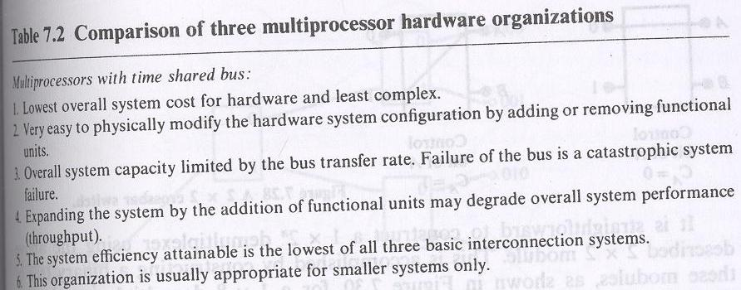

Slide 39
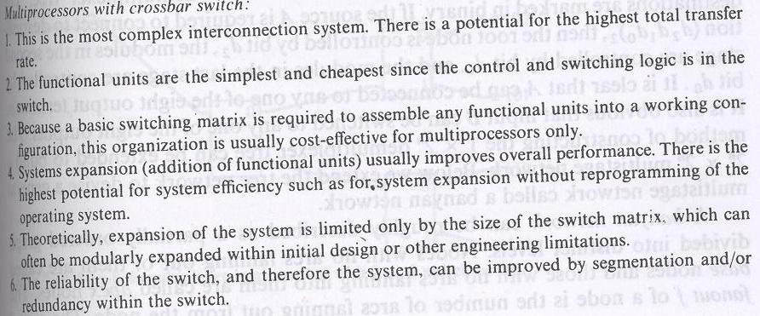

Slide 40
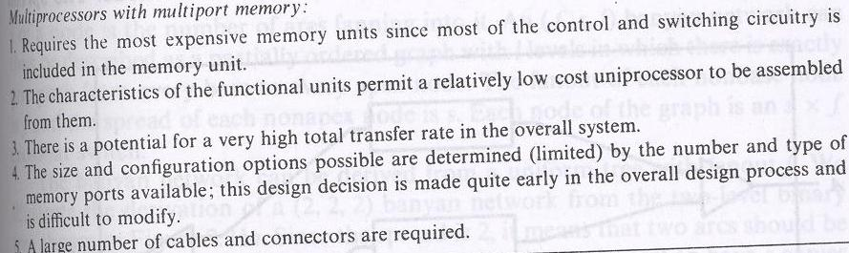

Slide 41
Multistage networks for multiprocessors
Consider the 2 x 2 cross bar switch

Slide 42
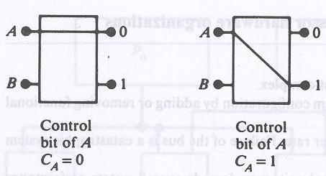

Slide 43
This 2 x 2 switch has the capability of connecting the i/p A to either the o/p labeled 0 or the o/p labeled 1, depending on the value of some control bit C_{A} of the i/p A. If C_{A}=0 the i/p is connected to the upper o/p and if C_{A}=1 the connection is made to the lower o/p.
Terminal B of the switch behaves similarly with a control bit C_{B}. If both i/ps A and B require the same o/p terminal, then only one of them will be connected and the other will be blocked or rejected.

Slide 44
The switch shown is not buffered. In such a switch, the performance may be limited by the switch setup time which is experienced each time with a rejected request is resubmitted.
To improve the performance buffers can be inserted within the switch.

Slide 45
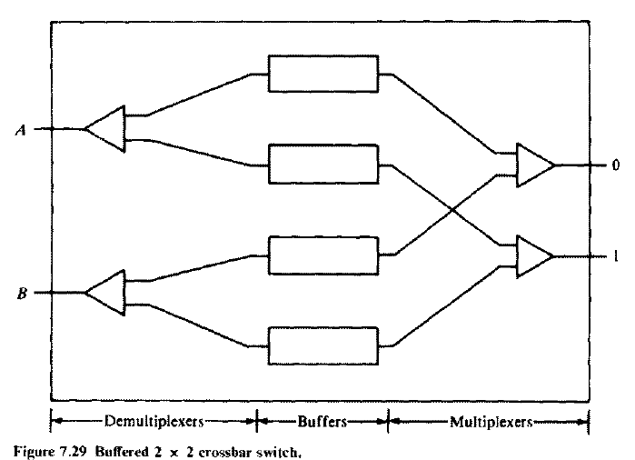

Slide 46
Such a switch has also been shown to be effective for packet switching when used in a multistage n/w.
It is straightforward to construct a 1 x 2^{n} demultiplexer using the 2 x 2 module.
This is accomplished by constructing a binary tree of the modules is shown for a 1 x8 demultiplexer tree.

Slide 47
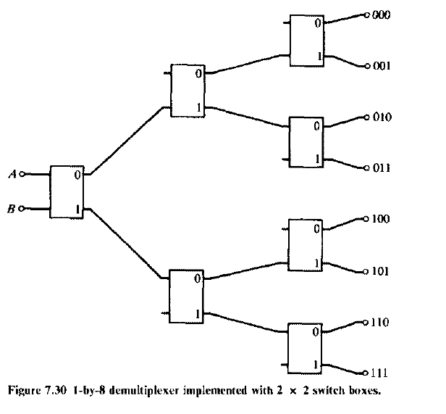

Slide 48
A banyan n/w can roughly be described as a partially ordered graph divided into distinct levels. Nodes with no arcs faning out of them are called base nodes and those with no arcs faning into them are called apex nodes.
The fanout f of a node is the no. of arcs faning out from the node. The spread s of a node is the no. of arcs faning into it.

Slide 49
An (f,s,l) Banyan n/w can thus be described as a partially ordered graph with l levels in which there is exactly one path from every base to every apex node. The fanout of each nonbase node is f and the spread of each nonapex node is s. Each node of the graph is an s x f crossbar switch.

Slide 50
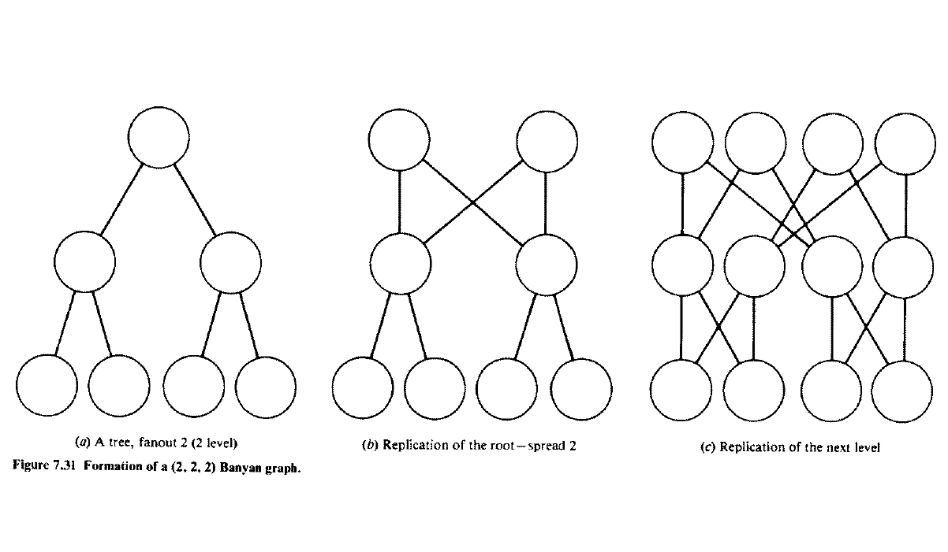

Slide 51
A delta network is defined as a^{n} x b^{n} switching n/w with n stages consisting of a x b crossbar modules.

Slide 52
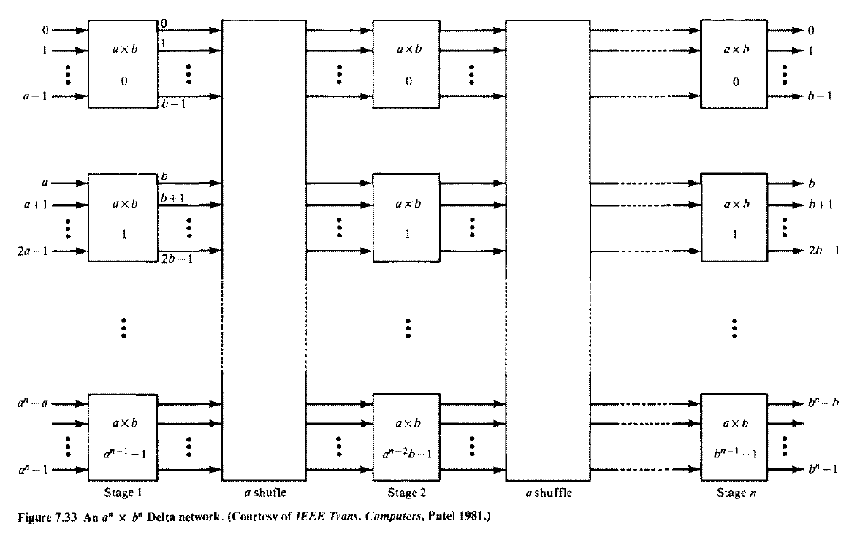

Slide 53
Performance of interconnection n/ws
Bandwidth is expressed in the avg. no. of memory requests accepted per cycle.
A cycle is defined as the time it takes for a request to propogate through the logic of the n/w + the time needed to access a memory word + the time used to return through the n/w to the source.

Slide 54
Analyze a p x m crossbar n/ws and delta n/ws for processor-memory interconnections. Do not distinguish the read or write cycles in this analysis.
The analysis is based on the following assumptions:
Each processor generates random and independent requests for a word in memory. The requests are uniformly distributed over all memory modules.

Slide 55
At the beginning of every cycle, each processor generates a new request with a probability r. Thus r is also the avg. no. of requests generated per cycle by each processor.
3. The requests which are blocked are ignored; that is the requests issued at the next cycle are independent of the requests blocked.

Slide 56
Language Features to Exploit Parallelism
Processes are concurrent if their executions overlap in time.
Two processes are concurrent if the first operation of one process starts before the last operation of the other process terminates.
In this case, no prior knowledge is available about the speed at which concurrent processes are executed.
Explicit concurrency, by which the programmer specifies the con­currency using certain language constructs.
One way to denote concurrency is to use FORK and JOIN statements.
FORK spawns a new process and JOIN waits for a previously created process to terminate

Slide 57
Generally, the FORK operation may be specified in three ways:
FORK A
FORK A, J
FORK A J, N.
The execution of the FORK A statement initiates another process at address A and continues the current process.
The execution of the FORK A, J statement causes the same action as FORK A and also increments a counter at address J.
FORK A, J, N causes the same action as FORK A and sets the counter at address J to N.
In all usages of the FORK state­ments, the corresponding JOIN statement is expressed as JOIN J.
The execution of this statement decrements the counter at J by one.
If the result is 0, the process at address J + 1 is initiated, otherwise the processor executing the JOIN state­ment is released.

Slide 58
Process 0
Language Features to Exploit Parallelism
Fork A,J,3
A
Process 0
Fork B
B
Join J
Process 1
Process 2
Join J
Join J
J
J+1
Process I
I ɛ |0,1,2|

Slide 59
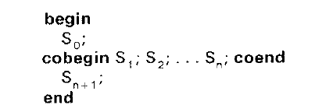
An equivalent extension of the FORK-JOIN concept is the block-structured language originally proposed by Dijkstra.
In this case, each process in a set of n processes S1, s2, … S_{n}, can be executed concurrently by using the following cobegin-coend (or parbegin-parend) constructs:
In this case, the block of statements between the cobegin-coend are executed concurrently only after the execution of statement S₀.
Statement S_{n} ₊ ₁ is executed only after all executions of the statements S1,S2,…Sn have been terminated.

Slide 60
Precedence graph of the concurrent program
S0
S1
S2
Sn
Sn+1

Slide 61
The set of statements S_{1,}S₂, …, S_{h} are executed concurrently as disjoint processes.
The disjointness implies that a variable v_{i} changed by statement Si cannot be referenced by another statement Sj, where j not equal to i.
In other words, a variable subject to change by a process must be strictly private to that process, but disjoint processes can refer to common variables not changed by any of them.
The compiler must be able to distinguish between variables that can be changed by a statement and variables that can be referenced by a statement but not changed by it. These two kinds of variables are called the variable parameters and constant parameters of a statement.
To make the checking of disjointness manageable, it is often necessary to restrict the use of pointer variables and procedure parameters. For example, a pointer variable may be bound to a set of variables of a given type as
var i, j, k: integer: p: pointer to i or j;

Slide 62
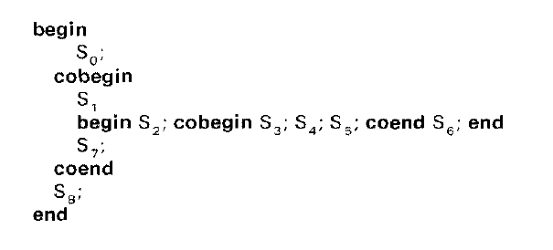

Slide 63
Precedence graph of concurrent nested process
S0
S2
S1
S3
S4
S5
S7
S6
S8

Slide 64

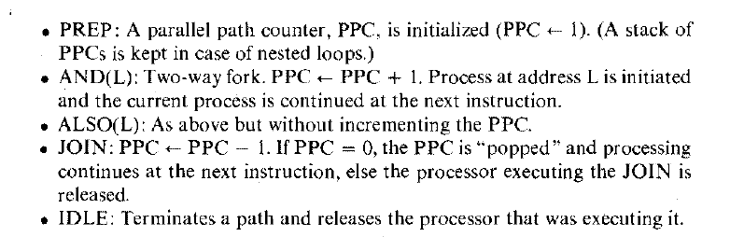

Slide 65
A1
I=0
PREP
Parfor I =1 until n do
Begin
A2
i=i+1
A3
If i>n GOTO A6
End
A4
AND( A2)
A5
BEGINS
END for i
A6
JOIN

Slide 66
A very common problem occurs when two or more concurrent processes share data which is modifiable.
If a process is allowed to access a set of variables that is being updated by another process concurrently, erroneous results will occur in the computation.
Therefore, controlled access of the shared variables should be required of the computations so as to guarantee that a process will have mutually exclusive access to the sections of programs and data which are modifiable. Such segments of programs are called critical sections.
The following assumptions are usually made regarding critical sections:
Mutual Exclusion; At most one process can be in a critical section at a time.
Termination: The critical section is executed in a finite time.
Fair Scheduling: A process attempting to enter the critical section will eventually do so in a finite time.

Slide 67
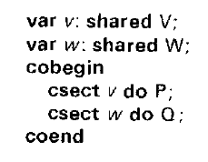
The mutually exclusive access to a set of shared variables can be accomplished by a number of constructs. An example is the MUTEXBEGIN and MUTEXEND constructs
The following is a notation used to declare a set of shared or common variables of type T: var v:shared T.
Then a critical section may be defined by csect v do S.
The definition associates a statement S with a common variable v and indicates that the statement S should have exclusive access to v.
Critical sections referring to different variables can be executed in parallel, as shown in the following example:

Slide 68
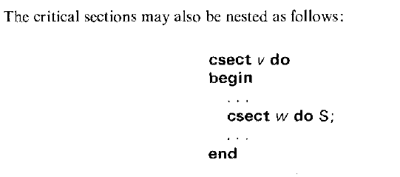

Slide 69
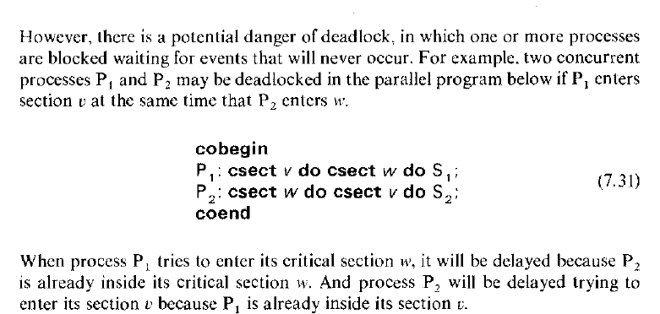

Slide 70
The deadlock occurs because two processes enter their critical sections in opposite order and create a situation in which each process is waiting indefinitely for the completion of a region within the other process.
This circular wait is a condition for deadlock.
.
Synchronization is a general term for timing constraints of this type of communication imposed on interactions between concurrent processes.
The simplest form of interaction is an exchange of liming signals between two processes.
A well-known example is the use of interrupts to signal the comple­tion of asynchronous peripheral operations lo the processor.
Another type of timing signals, events, was used in early multiprocessing systems to synchronize concurrent processes.

Slide 71
When a process decides to wait for an event, the execution of its next operation is delayed until another process signals the occurrence of the event.
The following program illustrates the transmission of timing signals from one process to another by means of a shared variable e of type event. Both processes are assumed to be cyclical. Notice that the concurrent operations wait and signal both access the same variable e.

Slide 72
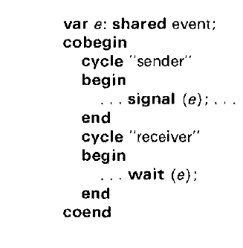

Slide 73
Process Synchronization
Assignment

Slide 74
THANK YOU

